Slide 1
JAVA NETWORKING

Slide 2
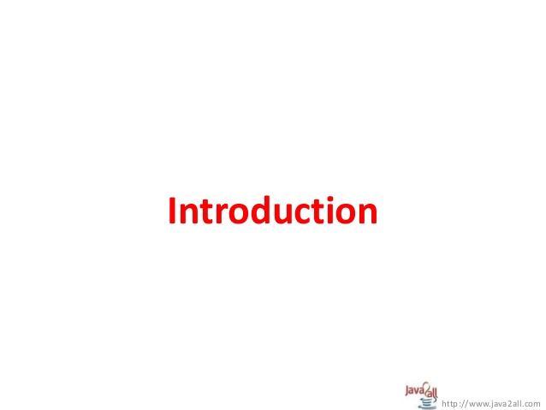

Slide 3
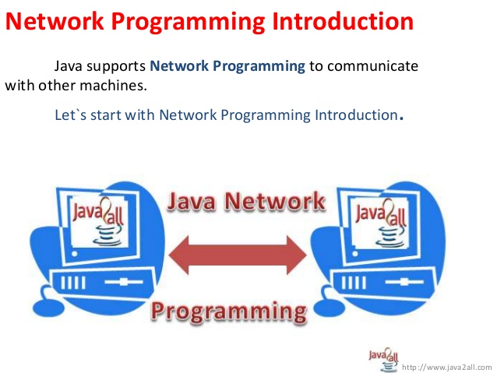

Slide 4
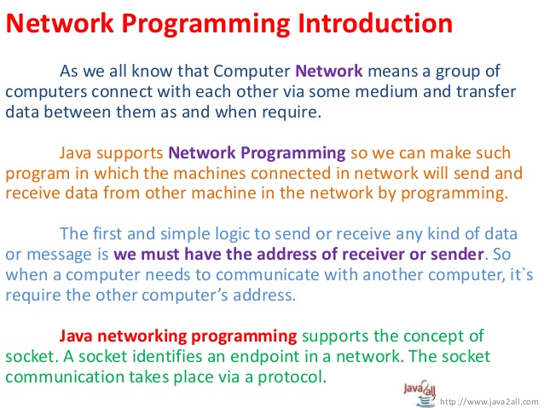

Slide 5
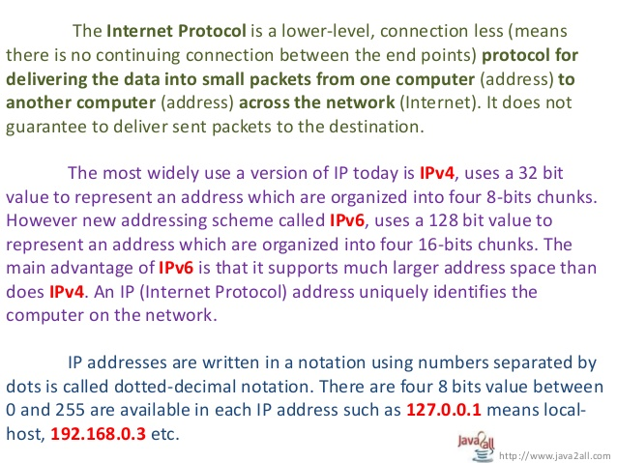

Slide 6
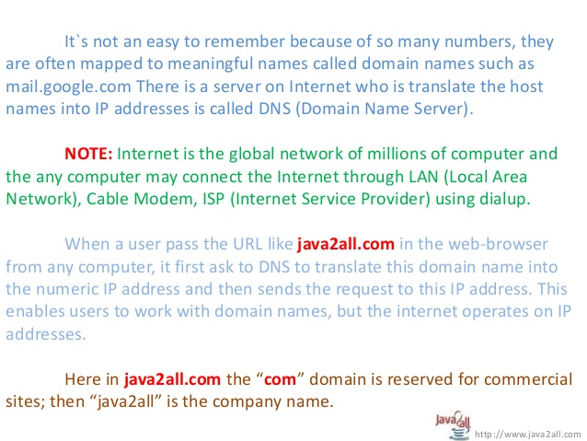

Slide 7
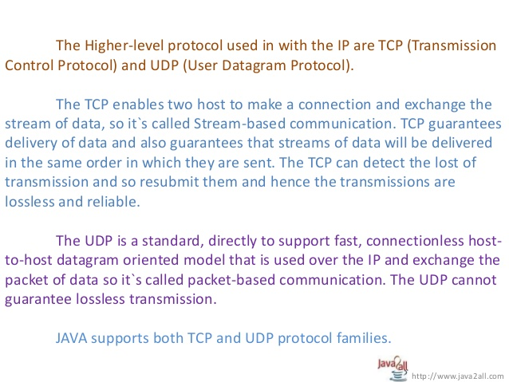

Slide 8
Java.net package

Slide 9
Purpose
This package is for providing the useful classes & interfaces for Networking application which are used in sockets & URL.

Slide 10
Interfaces of the java.net package
INTERFACE | DESCRIPTION | METHODS
ContentHandlerFactory | This interface defines a factory for contenthandler | createContentHandler(string MIME_type)-> creates content handler.
SocketImplFactory | This Interface is for defining the factory for implementing sockets. | createSocketImpl()-> creates a new instance for implementing sockets.
URLStreamHandlerFactory | This interface defines a factory for URL Stream protocol handler | createURLStreamHandler(String p)-> for specific protocol ‘p’ a new URLstreamHandler instance can be created using this method

Slide 11
Classes of java.net package
Name | Description
1.ContentHandler | The abstract class ContentHandler is the superclass of all classes that read an Object from a URLConnection.
2.DatagramSocket | This class represents a socket for sending and receiving datagram packets.
3.DatagramPacket | This class represents a datagram packet.
4.InetAddress | This class represents an Internet Protocol (IP) address.
5.InetSocketAddress | This class implements an IP Socket Address (IP address + port number) It can also be a pair (hostname + port number), in which case an attempt will be made to resolve the hostname.
6. ServerSocket | This class implements server sockets.
7.Socket | This class implements client sockets (also called just "sockets").

Slide 12
Classes of java.net package
Name | Description
8.SocketAddress | This class represents a Socket Address with no protocol attachment.
9.URL | Class URL represents a Uniform Resource Locator, a pointer to a "resource" on the World Wide Web.
10.URI | Represents a Uniform Resource Identifier (URI) reference.
11.URLConnection | The abstract class URLConnection is the superclass of all classes that represent a communications link between the application and a URL.
12.UnkownHostException | IF the IP address of corresponding Host could not be located then this kind of error is indicated
13.MalfomedURLException | This Exception is for indicating bad URL
14.BindException | If a failure occurs while binding socket to local address or port then this exception must be thrown.

Slide 13
Classes of java.net package
Name | Description
15.ConnectException | If connection between socket and remote address and port could not get established then this exception must be thrown.
16.ProtocolException | This Exception is for raising error in underlying protocol.
17.SocketException | This Exception is for raising error in Socket Communication.

Slide 14
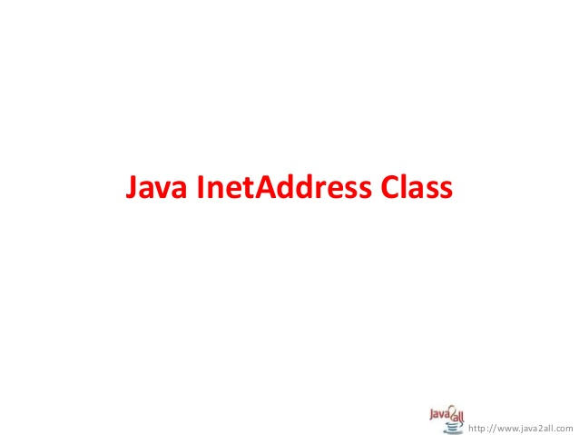

Slide 15
InetAddress
An IP address is just a number that corresponds to a particular host computer on the internet.
JAVA created a powerful class called InetAddress that represents an IP address.

Slide 16
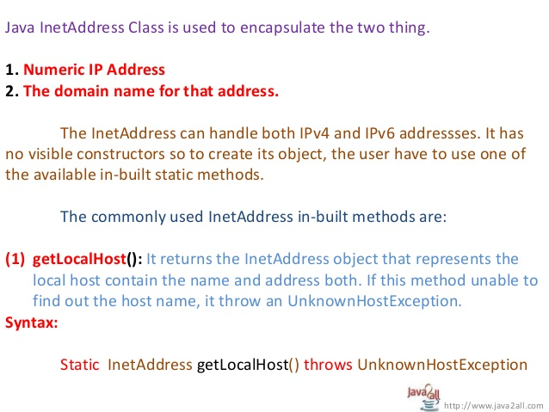

Slide 17
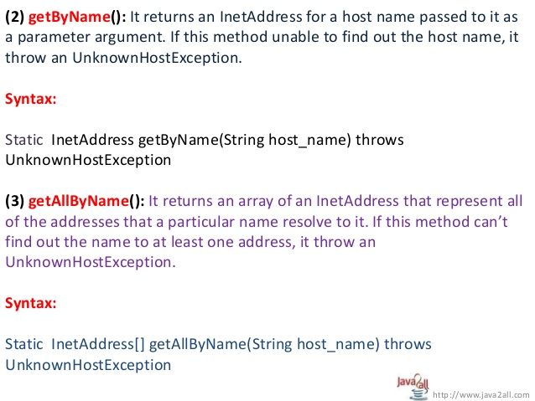

Slide 18
(4)getByAddress:-
1.static InetAddress getByAddress(byte []addr)
->It returns an InetAddress object given the raw IP address
2. static InetAddress getByAddress(String host,byte []addr)
->It creates an InetAddress based on provided host name and IP address NO name service is checked for the validity of the address.
(5)getHostAddress:-It returns the IP address string in textual presentation.
-> String getHostAddress()
(6)getHostName:-It gets the Host name for the IP address
-> String getHostName()

Slide 19
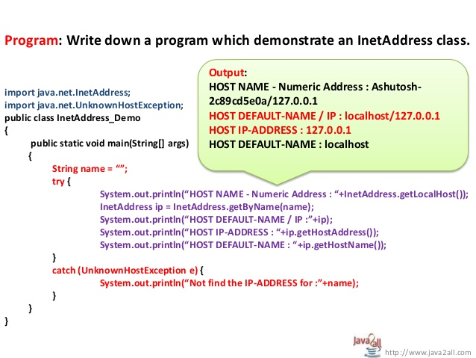

Slide 20
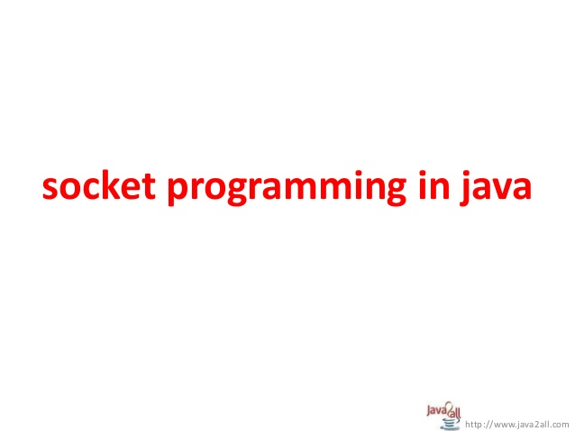

Slide 21
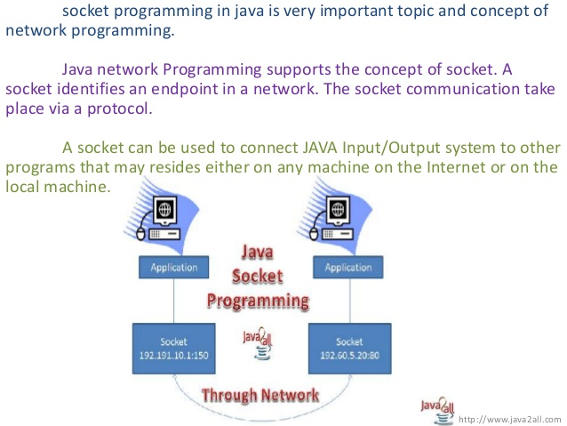

Slide 22
Typically the socket programs are Server & Client Program
A Server is a device which has resources and from which the services can be obtained
A Client is a device which wants to get Service from particular Server.
A Socket is bound to a port number so that the TCP/UDP from transport layer can identify the corresponding application at destination.
There are typically two types of Sockets-
-> TCP Sockets:-Which are denoted by streams
-> UDP Sockets:-Which are denoted by Datagrams.

Slide 23
Creating Networking application using TCP/IP socket
Network application will contain Client and Server. It will use TCP protocol for communication.
To create the network application, you need to perform the following steps.
1. Create a Server that delivers required information
2. Create a Client that receives the data delivered by the Server.
3.Executing the Server and Client Program.

Slide 24
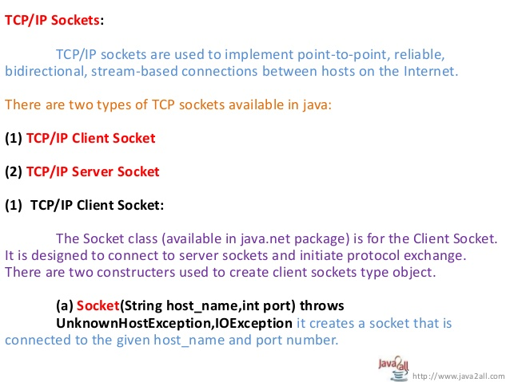

Slide 25
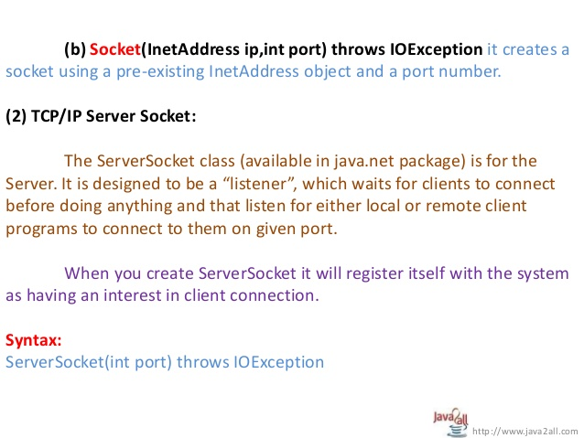

Slide 26
Creating Networking application using TCP/IP socket
Develop a Server that sends data
1. Create Server Socket with some port number.
ServerSocket ss= new ServerSocket(7777);
2. Make the server to wait till a client accept connection.
Socket s = ss.accept();
3. Attach output stream to the server socket using its getOutputStream() method.
4.Take another Stream, such as PrintStream, to send data to the client.
5.Send data to the client using the print() or println() method.
6.Close the connection.

Slide 27
Creating Networking application using TCP/IP socket
Develop a Client that receives Data
1.Create a Socket at the client side using the Socket class.
Socket s = new Socket(“IPAddress”, port number);
2.Add InputStream to the socket so that the socket will be able to receive the data on the InputStream.
InputStream obj= s.getInputStream();
3.Create a BufferedReaderobject to read the data.
4.Read the data using the read() or readLine() method.
5.Close the connection.

Slide 28
Creating Two-Way Networking application using TCP/IP socket
Develop a Server that sends data
1.Create Server Socket with some port number.
ServerSocketss= new ServerSocket(7777);
2.Make the server to wait till a client accept connection.
Socket s = ss.accept();
3.Attach InputStreamto the server socket using its getInputStream() method and BufferedReaderclass.
4.Attach output stream to the server socket using its getOutputStream() method.
5.Take another Stream, such as PrintStream, to send data to the client.
6.Send data to the client using the print() or println() method.
7.Close the connection.

Slide 29
Creating Two-Way Networking application using TCP/IP socket
Develop a Client that receives Data
1.Create a Socket at the client side using the Socket class.
Socket s = new Socket(“IPAddress”, port number);
2.Add InputStreamto the socket so that the socket will be able to receive the data on the InputStream.
InputStream obj= s.getInputStream();
3.Create a BufferedReaderobject to read the data.
4.Add OutputStreamto the socket so that the socket will be able to write the data on the OutputStream.
5.Read the data using the read() or readLine() method.
6.Close the connection.

Slide 30
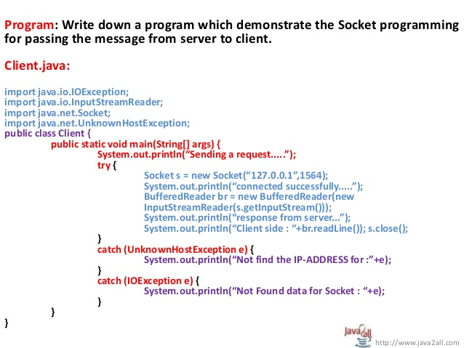

Slide 31
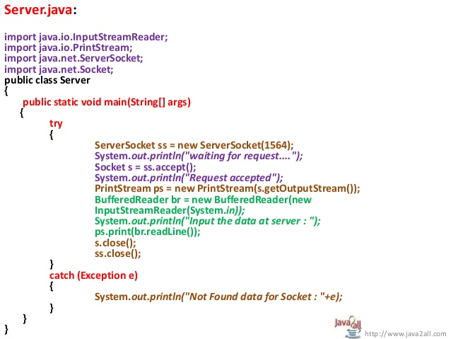

Slide 32
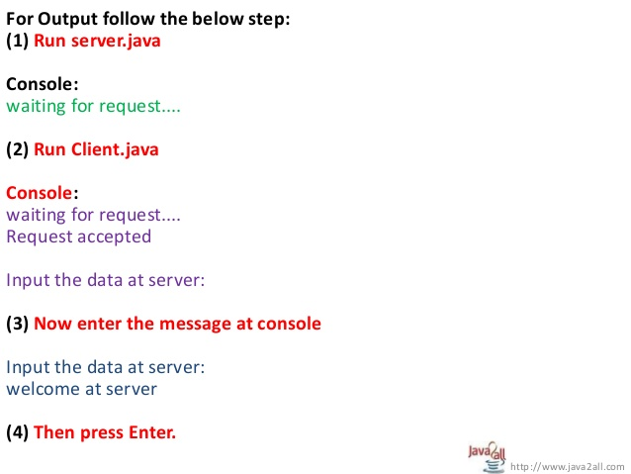

Slide 33
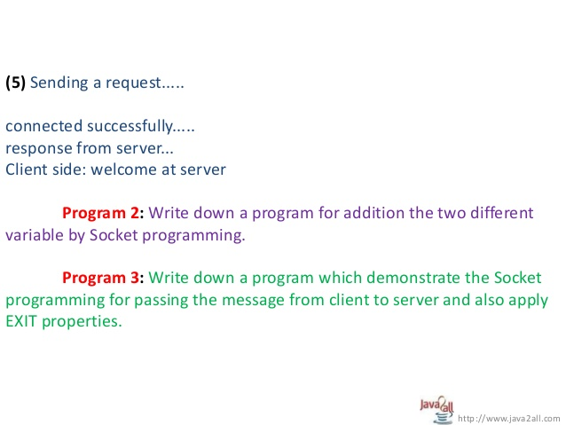

Slide 34
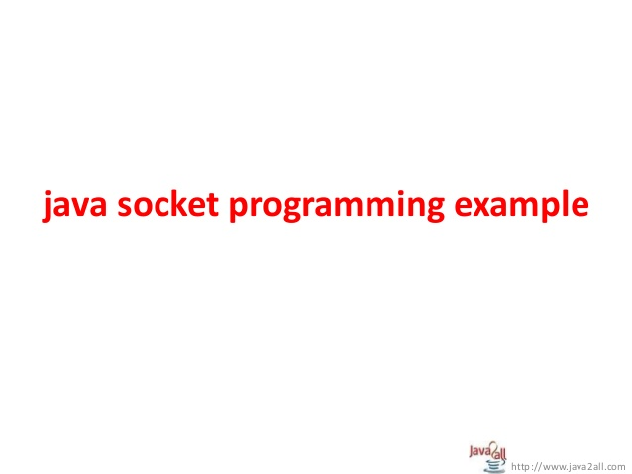

Slide 35
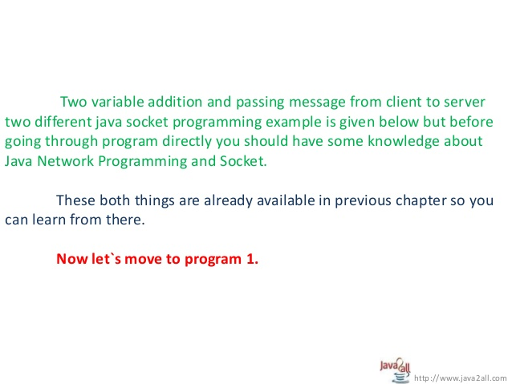

Slide 36
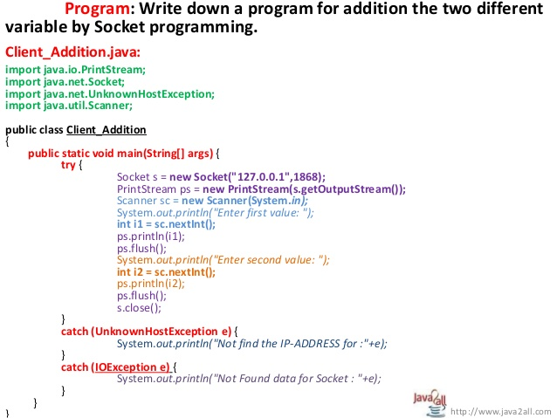

Slide 37
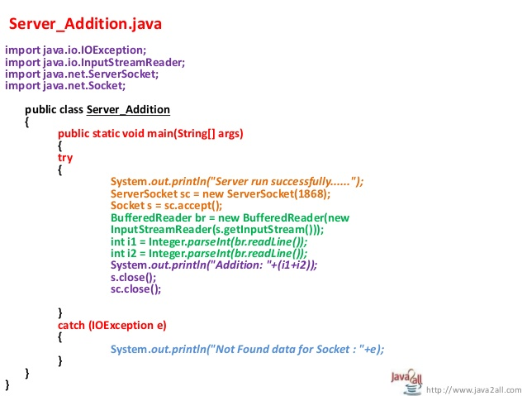

Slide 38
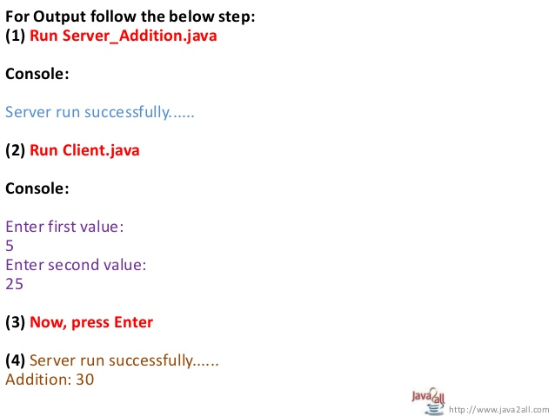

Slide 39
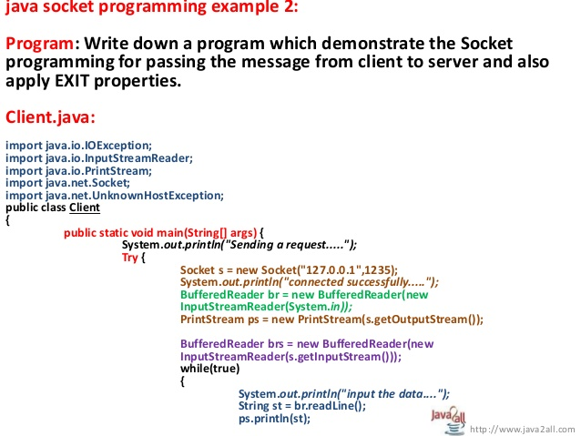

Slide 40
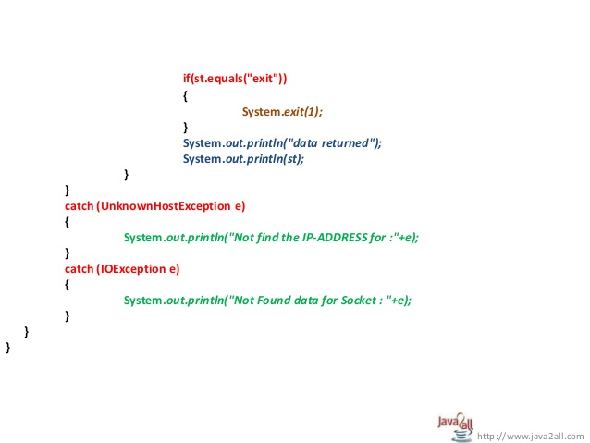

Slide 41
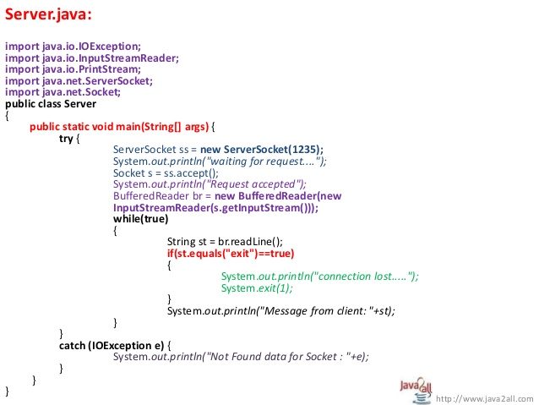

Slide 42
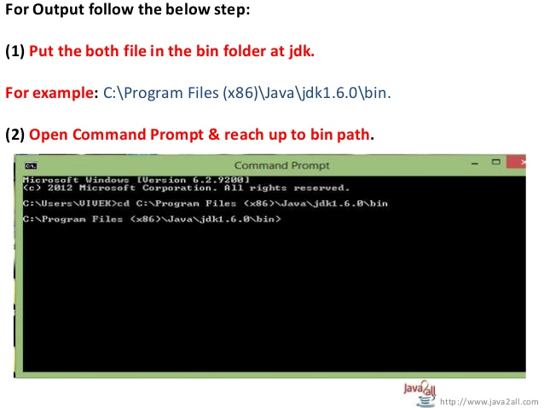

Slide 43
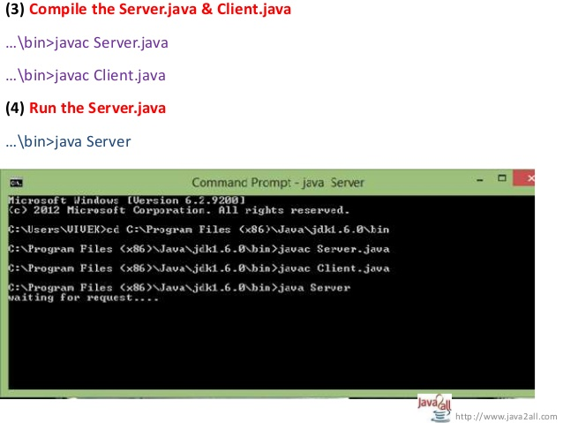

Slide 44
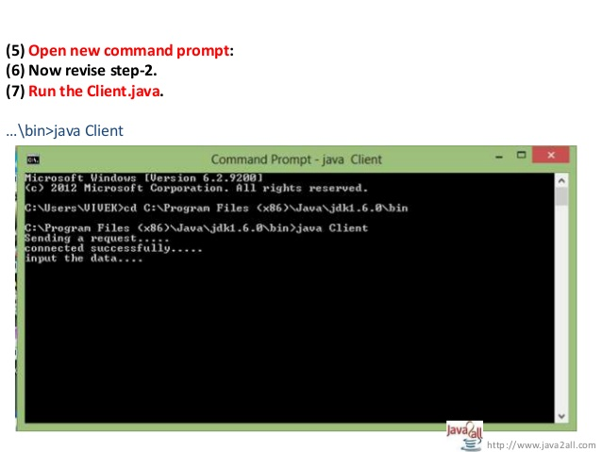

Slide 45
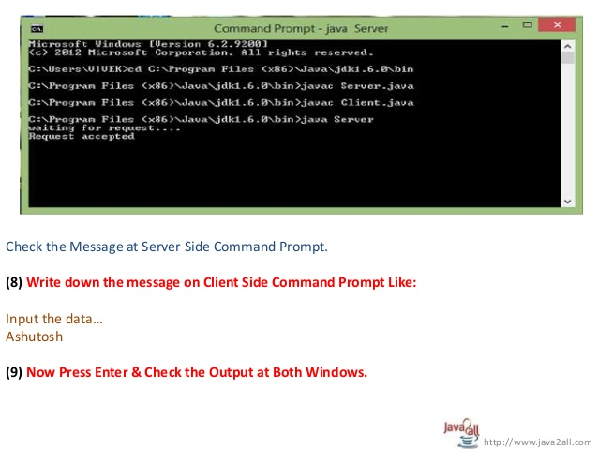

Slide 46
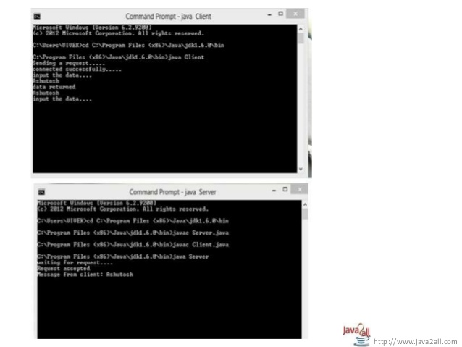

Slide 47
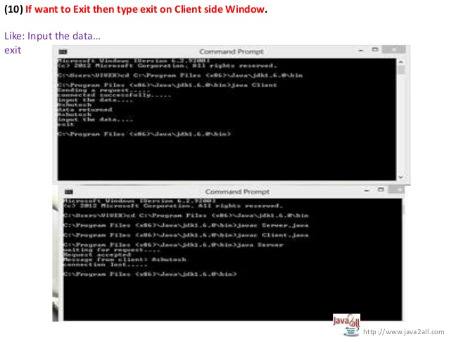

Slide 48
DatagramSocket & DatagramPacket
UDP transfers datagrams from a process executing in the source host to other process running in the destination host based on information contained within the datagram. Thus, it is implied that each datagram needs to have the destination address.
In this datagram might be routed differently, the datagram might arrive in any order at a receiver and the datagram delivery is not guaranteed.
Java offers datagram communication through the following classes in the Java.net package
->DatagramPacket
->DatagramSocket

Slide 49
DatagramSocket & DatagramPacket(Cont..)
DatagramPacket class
Constructors
(1)DatagramPacket(byte data[], int size);
(2)DatagramPacket(byte data[], int offset, intsize);
(3)DatagramPacket(byte data[], int size, InetAddress ipAddress, int port);
(4)DatagramPacket(byte data[], int offset, int size, InetAddress ipAddress, int port);

Slide 50
DatagramSocket & DatagramPacket(Cont..)
DatagramPacketclass (cont…)
Methods
(1)InetAddress getAddress();
(2)int getPort();
(3)Byte[] getData();
(4)int getLength();

Slide 51
DatagramSocket & DatagramPacket(Cont..)
DatagramSocketclass
Constructors
(1)DatagramSocket(int port);
(2)DatagramSocket(int port, InetAddress laddress);
Methods
(1)Void receive(DatagramPacket dp);
(2)Void send(DatagramPacket dp);

Slide 52
URL (Uniform Resource Locator)
It represents the address that is specified to access some information or resource on internet.
An example of URL is http://www.abc.com:80/index.html
The URL contains 4 parts which are as follows
1) The protocol to use (http://)
2) The Server name or IP address
3) Port number which is optional (by default :80)
4) The file(resource) that is referred.

Slide 53
URL (Uniform Resource Locator)(cont…)
It will create URL object in java application.
It has the following constructors
(1)URL(String urlSpecifier)
(2)URL(String protocol, String hostName, int port, String path);
(3)URL (String protocol, String hostName, String path);
(4)URL (URL urlObj, String urlSpecifier);

Slide 54
URL (Uniform Resource Locator)(Cont..)
It contains following instance methods
(1) String getProtocol();
(2) String getPort();
(3) String getHost();
(4) String getFile();
(5) URLConnection openConnection();

Slide 55
import java.net.*;
import java.io.*;
public class URLDemo
{
public static void main(String [] args)
{
try
{
URL url = new URL("http://www.amrood.com/index.html");
System.out.println("URL is " + url.toString());
System.out.println("protocol is " + url.getProtocol());
System.out.println("file name is " + url.getFile());
System.out.println("host is " + url.getHost());
System.out.println("path is " + url.getPath());
System.out.println("port is " + url.getPort());
System.out.println("default port is "+ url.getDefaultPort());
}catch(IOException e)
{
e.printStackTrace();
}
}
}

Slide 56
The Content & Protocol Handler
Content handlers in Java are the objects that are responsible for parsing the content of a Web page and showing it in the Web browser window, at the client side.
All content handlers extend an abstract class java.net.ContentHandler.
The content handlers are invoked whenever the getContent() method of the URLConnection class is invoked.
The job of the content handler is to read the data provided bye the protocol handler and use the data to construct a well-defined Java object.

Slide 57
The protocol handlers are the objects that are concerned with how the data arrives at an host.
Let’s consider an example of a protocol that delivers an object on the network in a compressed format, then it is the responsibility of the protocol handler to unpack the object prior to providing the object to the content handler.

Slide 58
The following code snippet shows the construction of an URL object that refers to a JPG image on an FTP archive and an attempt to fetch the content of the JPG file.
try
{
URL myURL= new URL(http://kogentindia/emp.jpg);
Image myIMG= (Image)myURL.getContent();
}
Catch(Exception e)
{
e.printStactTrace();
}

Slide 59
URLConnection class
This class is used to connect to a website or resource on a network and get all the details of resource on a website.
Using openConnection() method of the URL Object, contact with the resources on a website is established.
This method returns URLConnection class object.
Then using URLConnection class methods, we can display all the details of the resources on a website and also content of the webpage whose name is given in URL.

Slide 60
URLConnection class(Cont..)
This class contains the following methods
(1) Long getDate();
(2)Long getLastModified();
(3)Long getContentLength();
(4)InputStream getInputStream();

Slide 61
if (len == 0)
{
System.out.println("=== Content ===");
InputStream input = hpCon.getInputStream();
int i = len;
while ((c = input .read()) != -1) {
System.out.print((char) c);
}
input.close();
} else {
System.out.println("No Content Available");
}
}
}
import java.net.*;
import java.io.*;
import java.util.Date;
class UCDemo
{
public static void main(String args[]) throws Exception {
Int c;
URL hp = new URL("http://www.pu. ac.in/index.php");
URLConnection hpCon = hp.openConnection();
System.out.println("Date: " + new Date(hpCon.getDate()));
System.out.println("Content-Type: " + hpCon.getContentType());
System.out.println("Expires: " + hpCon.getExpiration());
System.out.println("Last-Modified: " +
new Date(hpCon.getLastModified()));
int len = hpCon.getContentLength();
System.out.println("Content-Length: " + len);

